Slide 1

Synchronization of Distributed Mobile Databases in a Mobile Application
Team Members:
Heney S Panicker HT035943M
Huang, Donghao HT035913N
Jerel Yam Wye Kede HT065749W

Slide 2
Outline
Introduction
System Architecture
Database Schema
Data Synchronization

Slide 3
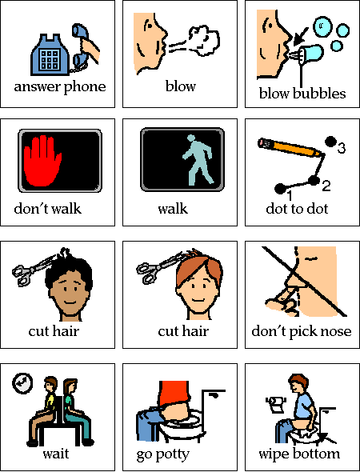
Introduction
The purpose of the ADA project is to use PDAs to assist people diagnosed with autism in learning environments and real life situations.
Since most autistic people think visually, symbols are widely used in ADA.

Slide 4
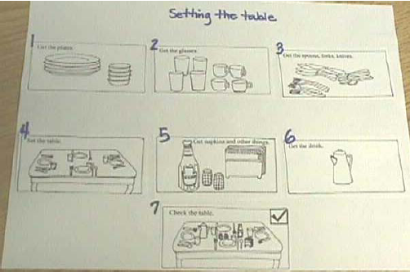
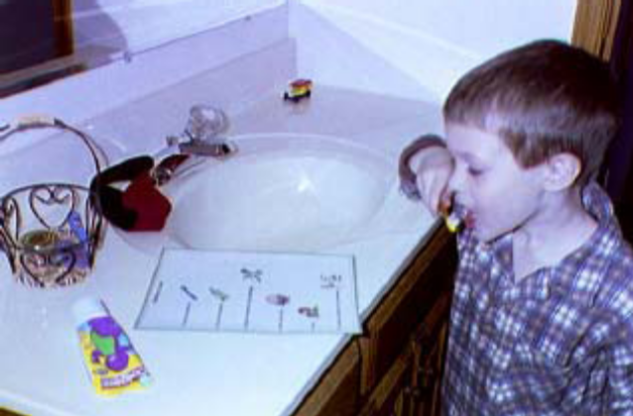
Task Organizer
Helps autistic children who may be unsure of the steps of an activity
Provide a visual representation of each part of a task.
Help children complete the sequence of a task in the right order.
Notes:
The use of task organizers helps autistic children who may be unsure of the steps of an activity
Task organizers are visual cues that show the steps of an activity
They provide a visual representation of each part of a task so a child always knows the next step
Pictures and/or written instructions (similar to a recipe) can be used to help children complete the sequence of a task in the right order.

Slide 5
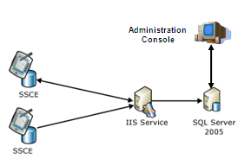
System Architecture: Technologies
Server
  SQL Server 2005
Pocket PC Client
  .NET Compact Framework 2.0
  SQL Server 2005 Compact Edition

Slide 6
System Architecture: Program Flow
Administration Console
Assign Device to User
Create Symbols
Create Task Organiser
SQL Server
Generate Reports
Analyse Data
PDA
Synchronization
SQLCE
PDA Push Execution Records to SQL Server
PDA pulls Task Organiser
Execute Task Organiser On PDA
Program Flow
DB Access

Slide 7
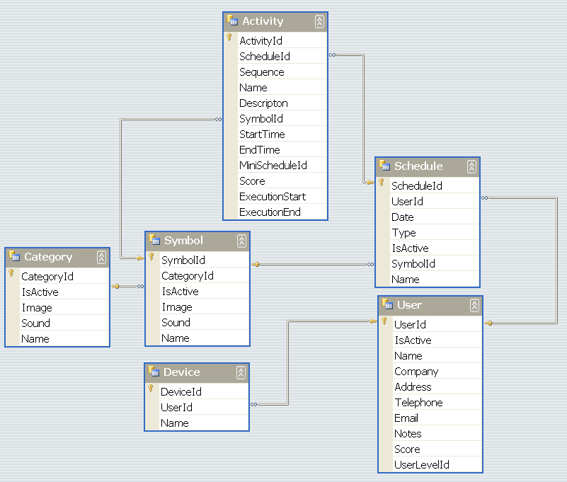
Database Schema

Slide 8
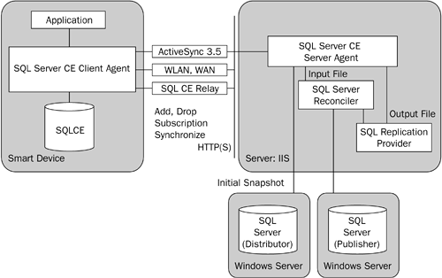
Data Synchronization: Merge Replication

Slide 9
Data Synchronization: Dynamic Filtering/Horizontal Partitioning
Allows only pertinent records to be pushed
Saves bandwidth
Reduces Synchronization time
Conserves storage space on mobile devices.
Eg.
SELECT <published_columns> FROM [dbo].[Device] WHERE [DeviceId]=HOST_NAME()

Slide 10
Demo

